Slide 1

CSC 350
Spring 2025
Foundations of Computer Science II
Elementary Logic

Slide 2
How Do We Reason?
We make arguments, where an argument is a sequence of statements, called premises, followed by a single statement, called the conclusion.
The hope is that we make valid arguments, where an argument is valid if the truth of the premises implies the truth of the conclusion.
We can use rules of logic to make valid arguments.
The most common rule of logic is modus ponens (mode that affirms). If P and Q are statements and “if P then Q” and P are both true, then we can conclude that Q is true.
Question. How did you learn the modus ponens rule as a child?
Notes:
modus ponens
If P implies Q is true => (P → Q)
And P is true => (P)
then Q will be true. => (∴ Q)
∴, denotes the conclusion that flows from the premises
Statement 1: If I am tired, then I need to rest. => P → Q
Statement 2: I am tired => P
Conclusion: Therefore, I need to rest => Q
Statement 1: If it is raining (P), then the streets are wet (Q). =>P→Q
Statement 2: It is raining. => P
Conclusion: Therefore, the streets are wet. => Q
https://www.geeksforgeeks.org/modus-ponens-in-ai/

Slide 3
How Do We Reason?
When a conclusion is made that does not follow from the premises the reasoning is called a non sequitur (it does not follow).
Question. What is a non sequitur that you have observed?
Some dictionary-type definitions of logic:
The study of the principles of reasoning, especially of the structure of statements and of methods to determine their validity.
A system of reasoning.
Valid reasoning.
In logic, a calculus is a language of expressions, where each expression has a value and there are rules to transform one expression into another that has the same value.
Notes:
non sequitur
A statement that does not logically follow a statement that came before it.
Jeff is very talented.
All engineers are talented.
Therefore, Jeff is an engineer.
When it’s sunny, I see my neighbor walking his dog.
He must only walk the dog when the sun is out.
We don’t like to hire plumbers because we’re from Alaska.
-------------------------------------------------------------
In logic, a calculus is a formal system that defines a set of well-formed formulas and rules of inference.

Slide 4
Propositional Calculus
Propositional calculus is the language of propositions (statements that are true or false).
We represent propositions by formulas called well-formed formulas (wffs) that are constructed from an alphabet consisting of:
Truth symbols | T (or True) and F (or False)
Propositional variables | uppercase letters (e.g. P and Q)
Connectives (operators) | ¬ (not, negation)
 | ∧ (and, conjunction)
 | ∨ (or, disjunction)
 | → (conditional, implication)
Parentheses symbols | ( and )
Notes:
WFFs can also be referred to as well-formed arguments

Slide 5
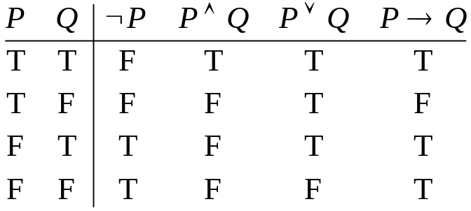
Propositional Calculus
A wff is either a truth symbol, a propositional variable, or if V and W are wffs, then so are
¬ V, V ∧ W, V ∨ W, V → W, and (W)
Example. The expression A ¬ B is not a wff. But each of the following three expressions is a wff:
A ∧ B → C, (A ∧ B) → C, and A ∧ (B → C)
Truth Tables. The connectives are defined by the following truth tables.
Notes:
Two common ways to read the expression P → Q are ‘
“if P then Q” and “P implies Q”
Less common
“Q if P”
“P is a sufficient condition for Q,”
“Q is a necessary condition for P”
P is called the antecedent and
Q is called the consequent of P → Q

Slide 6
Interpreting P → Q
Two common ways to read the expression P → Q are
“if P then Q” and “P implies Q”
Less common
“Q if P”
“P is a sufficient condition for Q,”
“Q is a necessary condition for P”
P is called the antecedent and
Q is called the consequent of P → Q

Slide 7
Semantics
The meaning of T (or True) is true
The meaning of F (or False) is false
The meaning of any other wff is its truth table, where in the absence of parentheses, we define the hierarchy of evaluation to be ¬, ∧, ∨, →, and we assume ∧, ∨, → are left associative.
Examples. ¬ A ∧ B means (¬ A) ∧ B
A ∨ B ∧ C means A ∨ (B ∧ C)
A ∧ B → C means (A ∧ B) → C
A → B → C means (A → B) → C.

Slide 8
Three Classes
A Tautology is a wff for which all truth table values are T.
A Contradiction is a wff for which all truth table values are F.
A Contingency is a wff that is neither a tautology nor a contradiction.
Examples. P ∨ ¬ P is a tautology.
P ∧ ¬ P is a contradiction.
P → Q is a contingency.

Slide 9
Equivalence
The wff V is equivalent to the wff W (written V ≡ W) iff V and W have the same truth value for each assignment of truth values to the propositional variables occurring in V and W.
Examples. ¬ A ∧ (B ∨ A) ≡ ¬ A ∧ B and
A ∨ ¬ A ≡ B ∨ ¬ B.

Slide 10
Equivalence and Tautologies
We can express equivalence in terms of tautologies as follows
V ≡ W iff (V → W) and (W → V) are tautologies.
Proof:
V ≡ W iff V and W have the same truth values
iff (V → W) and (W → V) are tautologies. QED.
(QED: “this completes the proof”)
Notes:
QED: "this completes the proof", "as required", "as desired", "as expected", "hence proved", "ergo", "so correct“

Slide 11
Basic Equivalences that Involve
True and False
The following equivalences are easily checked with truth tables:
A ∧ True ≡ A | A ∨ True ≡ True | A → True ≡ True | True → A ≡ A
A ∧ False ≡ False | A ∨ False ≡ A | A → False ≡ ¬ A | False → A ≡ True
A ∧ ¬ A ≡ False |  | A ∨ ¬ A ≡ True | A → A ≡ True

Slide 12
Other Basic Equivalences
The connectives ∧ and ∨ are commutative, associative, and distribute over each other. These properties and the following equivalences can be checked with truth tables:
A ∧ A ≡ A | ¬ (A ∧ B) ≡ ¬ A ∨ ¬ B | A ∧ (A ∨ B) ≡ A | A ∧ (¬ A ∨ B) ≡ A ∧ B
A ∨ A ≡ A | ¬ (A ∨ B) ≡ ¬ A ∧ ¬ B | A ∨ (A ∧ B) ≡ A | A ∨ (¬ A ∧ B) ≡ A ∨ B
¬ ¬ A ≡ A | A → B ≡ ¬ A ∨ B | ¬ (A → B) ≡ A ∧ ¬ B

Slide 13
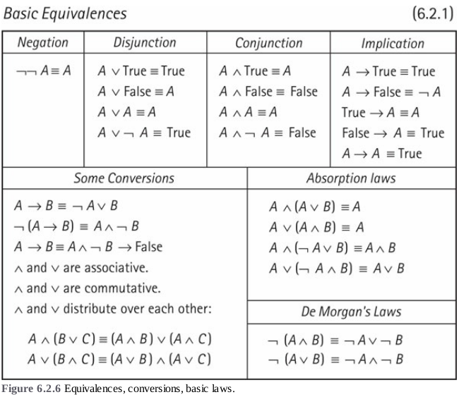
Notes:
Figure 6.2.6 is from the book.

Slide 14
Absorption Laws
If P → Q, then P → P and Q.
Q is "absorbed" by the term P
P → Q
------------------------
∴ P → (P and Q)
∴, denotes the conclusion that flows from the premises
Example. A ∧ (A ∨ B) ≡ A
Notes:
Absorption Laws:
If P implies Q, then P implies P and Q.
(Q is "absorbed" by the term P)
P implies Q
------------------------
∴ P implies (P and Q)
∴, denotes the conclusion that flows from the premises

Slide 15
De Morgan’s Laws
The negation of "A and B" is the same as "not A or not B".
¬ (A ∧ B) ≡ ¬ A ∨ ¬ B
The negation of "A or B" is the same as "not A and not B".
¬ (A ∨ B) ≡ ¬ A ∧ ¬ B
Notes:
De Morgan’s Laws:
The negation of "A and B" is the same as "not A or not B".
The negation of "A or B" is the same as "not A and not B".

Slide 16
Using Equivalences To Prove
Other Equivalences
We can often prove an equivalence without truth tables because of the following two facts:
If U ≡ V and V ≡ W, then U ≡ W.
If U ≡ V, then any wff W that contains U is equivalent to the wff obtained from W by replacing an occurrence of U by V.
Example. Use equivalences to show that A ∨ B → A ≡ B → A.
Proof: A ∨ B → A ≡ ¬ (A ∨ B) ∨ A (P → Q ≡ ¬ P ∨ Q)
≡ (¬ A ∧ ¬ B) ∨ A
≡ (¬ A ∨ A) ∧ (¬ B ∨ A)
≡ True ∧ (¬ B ∨ A)
≡ ¬ B ∨ A
≡ B → A. QED.
Notes:
P implies Q is equivalent to not P or Q
P → Q ≡ ¬ P ∨ Q

Slide 17
Exercise
Use known equivalences in each case.
1. Prove that A ∨ B → C ≡ (A → C) ∧ (B → C).
2. Prove that (A → B) ∨ (¬ A → B) is a tautology (i.e., show it is equivalent to true)
3. Prove that A → B ≡ (A ∧ ¬ B) → False .
4. Use absorption to simplify (P ∧ Q ∧ R) ∨ (P ∧ R) ∨ R.
5. Use absorption to simplify (S → T) ∧ (U ∨ T ∨ ¬ S).
Notes:
A ∨ B → C
≡ (¬ (A ∨ B)) ∨ C (P → Q ≡ ¬ P ∨ Q)
≡ (¬ A ∧ ¬ B) ∨ C (De Morgan’s Laws)
≡ (¬ A ∨ C) ∧ (¬ B ∨ C) (distributive)
≡ (A → C) ∧ (B → C) (¬ P ∨ Q ≡ P → Q)
(A → B) ∨ (¬ A → B)
≡ (¬ A ∨ B) ∨ (A ∨ B)
≡ ¬ A ∨ A ∨ B
≡ True ∨ B (A ∨ ¬ A ≡ True)
≡ True
A → B
≡ ¬ A ∨ B (P → Q ≡ ¬ P ∨ Q)
≡ ¬ (¬ A ∨ B) → False (¬ P ≡ P → False)
≡ (A ∧ ¬ B) → False (De Morgan’s Laws)
(P ∧ Q ∧ R) ∨ (P ∧ R) ∨ R
≡ (P ∧ R) ∨ R (A ∨ (A ∧ B) ≡ A)
≡ R (A ∨ (A ∧ B) ≡ A)
(S → T) ∧ (U ∨ T ∨ ¬ S)
≡ (S → T) ∧ (U ∨ (S → T)) (¬ P ∨ Q ≡ P → Q)
≡ (S → T) (A ∨ (A ∧ B) ≡ A)

Slide 18
Quine’s Method
Quine’s method uses these properties together with basic equivalences to determine whether a wff is a tautology, a contradiction, or a contingency.

Slide 19
Is it a Tautology, a Contradiction, or a Contingency?
If P is a variable in a wff W, let W(P/True) denote the wff obtained from W by replacing all occurrences of P by True. W(P/False) is defined similarly.
The following properties hold:
W is a tautology iff W(P/True) and W(P/False) are tautologies.
W is a contradiction iff W(P/True) and W(P/False) are contradictions.

Slide 20
Quine’s Method - Example
Let W = (A ∧ B → C) ∧ (A → B) → (A → C). Then we have
W(A/False) = (False ∧ B → C) ∧ (False → B) → (False → C)
≡ (False → C) ∧ True → True ≡ True .
So W(A/False) is a tautology. Next look at
W(A/True) = (True ∧ B → C) ∧ (True → B) → (True → C) ≡ (B → C) ∧ B → C.
Let X = (B → C) ∧ B → C. Then we have
X(B/True) = (True → C) ∧ True → C ≡ C ∧ True → C ≡ C → C ≡ True.
X(B/False) = (False → C) ∧ False → C ≡ False → C ≡ True.
So X is a tautology. Therefore, W is a tautology.

Slide 21
Exercise
Use Quine’s method in each case.
Show that (A ∨ B → C ) ∨ A → (C→ B) is NOT a tautology.
Show that (A → B) ∧ (B → C) → (A → C) is a tautology.
Notes:
1.
W = (A ∨ B → C ) ∨ A → (C→ B)
W(A/True) = (True ∨ B → C ) ∨ True → (C→ B)
≡ True → (C→ B)
≡ C→ B
2.
W = (A → B) ∧ (B → C) → (A → C)
W(A/False) = (False → B) ∧ (B → C) → (False → C)
≡ True ∧ (B → C) → True
≡ (B → C) → True
≡ True
W(A/True) = (True → B) ∧ (B → C) → (True → C)
≡ B ∧ (B → C) → C
X = B ∧ (B → C) → C
X(B/True) = True ∧ (True → C) → C
≡ (True → C) → C
≡ C → C
≡ True
X(B/False) = False ∧ (False → C) → C
≡ False → C
≡ True
Thus, W(A/True) is a tautology.
Therefore, W is a tautology.

Slide 22
Normal Forms
A literal is either a propositional variable or its negation. (e.g., A and ¬ A are literals.)
A disjunctive normal form (DNF) is a wff of the form C₁ ∨ … ∨ C_{n}, where each C_{i} is a conjunction of literals, called a fundamental conjunction.
A conjunctive normal form (CNF) is a wff of the form D₁ ∧ … ∧ D_{n}, where each D_{i} is a disjunction of literals, called a
fundamental disjunction.
Notes:
Disjunctive normal form (DNF): C₁ ∨ C₂ ∨ C₃ ∨ … ∨ C_{n}
C₁, C₂, C₃, … , C_{n} are a fundamental conjunction
Conjunctive normal form (CNF): D₁ ∨ D₂ ∨ D₃ ∨ … ∨ D_{n}
D₁, D₂, D₃, … , D_{n} are a fundamental disjunction

Slide 23
Normal Forms - Examples
(A ∧ B) ∨ (¬ A ∧ C ∧ ¬ D) is a DNF.
(A ∨ B) ∧ (¬ A ∨ C) ∧ (¬ C ∨ ¬ D) is a CNF.
The wffs A, ¬ B, A ∨ ¬ B, and A ∧ ¬ B are both DNF and CNF.
Why?
Notes:
DNF
C_{i} : fundamental conjunction
CNF
D_{i} : fundamental disjunction
A, DNF: A ∨ A., CNF: A ∧ A
¬ B, DNF: ¬ B ∨ ¬ B, CNF: ¬ B ∧ ¬ B
A ∨ ¬ B, Trivial DNF, CNF: (A ∨ ¬ B) ∧ (A ∨ ¬ B)
A ∧ ¬ B, DNF: (A ∧ ¬ B) ∨ (A ∧ ¬ B), Trivial CNF

Slide 24
Any wff has a DNF and a CNF
For any propositional variable A we have
True ≡ A ∨ ¬ A and False ≡ A ∧ ¬ A.
Both forms are DNF and CNF.
For other wffs use basic equivalences to:
remove conditionals,
move negations to the right, and
transform into required form. Simplify where desired.

Slide 25
Any wff has a DNF and a CNF - Example
(A → B ∨ C) → (A ∧ D)
≡ ¬ (A → B ∨ C) ∨ (A ∧ D) (X → Y ≡ ¬ X ∨ Y)
≡ (A ∧ ¬ (B ∨ C)) ∨ (A ∧ D) (¬ (X → Y) ≡ X ∧ ¬ Y)
≡ (A ∧ ¬ B ∧ ¬ C) ∨ (A ∧ D) (¬ (X ∨ Y) ≡ ¬ X ∧ ¬ Y) (DNF)
≡ ((A ∧ ¬ B ∧ ¬ C) ∨ A) ∧ ((A ∧ ¬ B ∧ ¬ C) ∨ D) (distribute ∨ over ∧)
≡ A ∧ ((A ∧ ¬ B ∧ ¬ C) ∨ D) (absorption)
≡ A ∧ (A ∨ D) ∧ (¬ B ∨ D) ∧ (¬ C ∨ D) (distribute ∨ over ∧) (CNF)
≡ A ∧ (¬ B ∨ D) ∧ (¬ C ∨ D) (absorption) (CNF).

Slide 26
Exercise
Transform (A ∧ B) ∨ ¬ (C → D) into DNF and into CNF.
Notes:
(A ∧ B) ∨ ¬ (C → D)
≡ (A ∧ B) ∨ ¬ (¬ C ∨ D)
≡ (A ∧ B) ∨ (C ∧ ¬ D) (DNF)
≡ ((A ∧ B) ∨ C) ∧ ((A ∧ B) ∨ ¬ D)
≡ (A ∨ C) ∧ (B ∨ C) ∧ (A ∨ ¬ D) ∧ (B ∨ ¬ D) (CNF)

Slide 27
Every Truth Function Is a Wff
A truth function is a function whose arguments and results take values in {true, false}. So, a truth function can be represented by a truth table. The task is to find a wff with the same truth table. We can construct both a DNF and a CNF.
Technique.
To construct a DNF, take each line of the table with a true value and construct a fundamental conjunction that is true only on that line. To construct a CNF, take each line with a false value and construct a fundamental disjunction that is false only on that line.

Slide 28
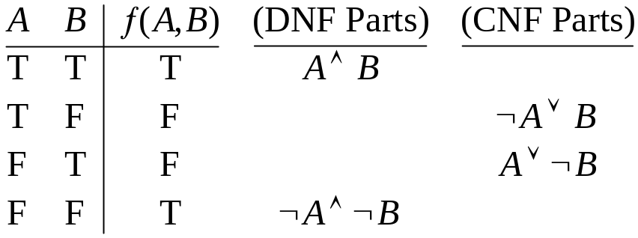
Every Truth Function Is a Wff - Example
Let ƒ be defined by ƒ(A, B) = if A = B then True else False.
The picture shows the truth table for ƒ together with the fundamental conjunctions for the DNF and the fundamental disjunctions for the CNF.
So ƒ(A, B) can be written as follows:
ƒ(A, B) ≡ (A ∧ B) ∨ (¬ A ∧ ¬ B) (DNF)
ƒ(A, B) ≡ (¬ A ∨ B) ∧ (A ∨ ¬ B) (CNF)
Notes:
DNF
C_{i} : fundamental conjunction
CNF
D_{i} : fundamental disjunction

Slide 29
Full CNF and Full DNF
A DNF for a wff W is a Full DNF if each fundamental conjunction contains the same number of literals, one for each propositional variable of W.
A CNF for a wff W is a Full CNF if each fundamental disjunction contains the same number of literals, one for each propositional variable of W.
Examples.
Full DNF: (P ∧ Q ∧ R) ∨ (¬ P ∧ Q ∧ R)
DNF: P ∨ (¬ P ∧ Q)
Full CNF: (P ∨ Q ∨ R) ∧ (¬ P ∨ Q ∨ R)
CNF: P ∧ (¬ P ∨ Q)
Notes:
Full DNF: (P ∧ Q ∧ R) ∨ (¬ P ∧ Q ∧ R)
DNF: P ∨ (¬ P ∧ Q)
Q does not occur in the first fundamental conjunction
Full CNF: (P ∨ Q ∨ R) ∧ (¬ P ∨ Q ∨ R)
CNF: P ∧ (¬ P ∨ Q)
Q does not occur in the first fundamental disjunction

Slide 30
Constructing Full DNF and Full CNF
We can use the technique for truth functions to find a full DNF or full CNF for any wff with the restriction that a tautology does not have a full CNF and a contradiction does not have a full DNF.
For example,
True ≡ A ∨ ¬ A,
which is a full DNF and a CNF,
but it is not a full CNF.
False ≡ A ∧ ¬ A,
which is a full CNF and a DNF,
but it is not a full DNF.

Slide 31
Alternative Constructions for
Full DNF and Full CNF
Use basic equivalences together with the following tricks to add a propositional variable A to a wff W:
W ≡ W ∧ True ≡ W ∧ (A ∨ ¬ A) ≡ (W ∧ A) ∨ (W ∧ ¬ A).
W ≡ W ∨ False ≡ W ∨ (A ∧ ¬ A) ≡ (W ∨ A) ∧ (W ∨ ¬ A).
Example. Find a full DNF for (A ∧ ¬ B) ∨ (A ∧ C).
Answer.
(A ∧ ¬ B ∧ C) ∨ (A ∧ ¬ B ∧ ¬ C) ∨ (A ∧ C ∧ ¬ B) ∨ (A ∧ C ∧ B), which can be simplified to:
(A ∧ ¬ B ∧ C) ∨ (A ∧ ¬ B ∧ ¬ C) ∨ (A ∧ C ∧ B),
Exercise. Find a full CNF for ¬ A ∧ B.
Ans. (¬ A ∨ B) ∧ (¬ A ∨ ¬ B) ∧ (B ∨ A) ∧ (B ∨ ¬ A) ≡ (¬ A ∨ B) ∧ (¬ A ∨ ¬ B) ∧ (B ∨ A).
Notes:
Find a Full DNF:
(A ∧ ¬ B) ∨ (A ∧ C)
≡ (A ∧ (¬ B ∧ True)) ∨ (A ∧ C)
≡ (A ∧ (¬ B ∧ (C ∨ ¬ C))) ∨ (A ∧ C)
≡ (A ∧ ((¬ B ∧ C) ∨ (¬ B ∧ ¬ C))) ∨ (A ∧ C)
≡ (A ∧ (¬ B ∧ C)) ∨ (A ∧ (¬ B ∧ ¬ C)) ∨ (A ∧ C)
≡ (A ∧ (¬ B ∧ C)) ∨ (A ∧ (¬ B ∧ ¬ C)) ∨ (A ∧ (C ∧ True))
≡ (A ∧ (¬ B ∧ C)) ∨ (A ∧ (¬ B ∧ ¬ C)) ∨ (A ∧ (C ∧ (B ∨ ¬ B)))
≡ (A ∧ (¬ B ∧ C)) ∨ (A ∧ (¬ B ∧ ¬ C)) ∨ (A ∧ ((C ∧ B) ∨ (C ∧ ¬ B)))
≡ (A ∧ (¬ B ∧ C)) ∨ (A ∧ (¬ B ∧ ¬ C)) ∨ (A ∧ (C ∧ B)) ∨ (A ∧ (C ∧ ¬ B))
≡ (A ∧ ¬ B ∧ C) ∨ (A ∧ ¬ B ∧ ¬ C) ∨ (A ∧ C ∧ B) ∨ (A ∧ C ∧ ¬ B)
Answer:
≡ (A ∧ ¬ B ∧ C) ∨ (A ∧ ¬ B ∧ ¬ C) ∨ (A ∧ C ∧ ¬ B) ∨ (A ∧ C ∧ B)
Simplified answer:
≡ (A ∧ ¬ B ∧ C) ∨ (A ∧ ¬ B ∧ ¬ C) ∨ (A ∧ C ∧ B)
Find a Full CNF:
¬ A ∧ B
≡ (¬ A ∨ False) ∧ B
≡ (¬ A ∨ (B ∧ ¬ B)) ∧ B
≡ (¬ A ∨ B) ∧ (¬ A ∨ ¬ B) ∧ B
≡ (¬ A ∨ B) ∧ (¬ A ∨ ¬ B) ∧ (B ∨ False)
≡ (¬ A ∨ B) ∧ (¬ A ∨ ¬ B) ∧ (B ∨ (A ∧ ¬ A))
≡ (¬ A ∨ B) ∧ (¬ A ∨ ¬ B) ∧ (B ∨ A) ∧ (B ∨ ¬ A)
Answer:
≡ (¬ A ∨ B) ∧ (¬ A ∨ ¬ B) ∧ (B ∨ A) ∧ (B ∨ ¬ A)
≡ (¬ A ∨ B) ∧ (¬ A ∨ ¬ B) ∧ (B ∨ A)

Slide 32
Complete Sets of Connectives
A set S of connectives is complete if every wff is equivalent to a wff constructed from S.
So {¬, ∧, ∨, →} is complete by definition.
Examples.
Each of the following sets is a complete set of connectives.
{¬, ∧, ∨}, {¬, ∧}, {¬, ∨}, {¬, →},
{False, →}, {NAND}, {NOR}
Exercise. Show that {¬, →} is a complete.
Exercise. Show that {if-then-else, True, False} is a complete.
Notes:
NAND: Negation of AND
¬ P≡ NAND(P,P)
NOR: Negation of OR
{¬, →}
Given that {¬, ∨} is adequate
Show that ∨ can be written in terms of ¬ and →
A ∨ B
≡ ¬ (¬ A) ∨ B
≡ ¬ A → B
{AND, OR, NOT}
AND(A,B) = if A then B else False
OR(A,B) = if A then True else B
NOT(A) = if A then False else True

Slide 33
Section 6.3 Formal Reasoning
Notes:
Review slide 2 on premises and conclusion

Slide 34
Formal Reasoning
We make arguments, where an argument is a sequence of statements, called premises, followed by a single statement, called the conclusion.
Premises: A ∨ B,
¬ A,
C → D
Conclusion: C ∧ D

Slide 35
Formal Reasoning
A formal proof (or derivation) is a sequence of wffs, where each wff is either a premise or the result of applying a proof rule (or inference rule) to certain previous wffs in the sequence.
Notes:
The goal is to show that an argument is valid by using a formal proof process that uses a specific set of rules
Natural deduction:
logical reasoning is expressed by inference rules that reflect the informal (i.e., natural) way of reasoning
We will not be covering the axiomatic approach (in section 6.4).

Slide 36
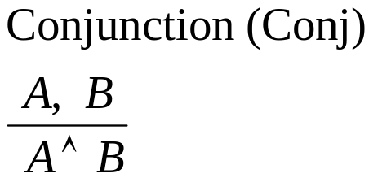
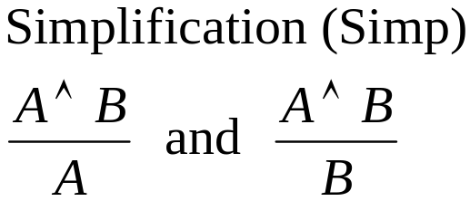
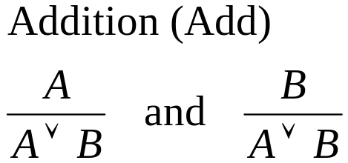
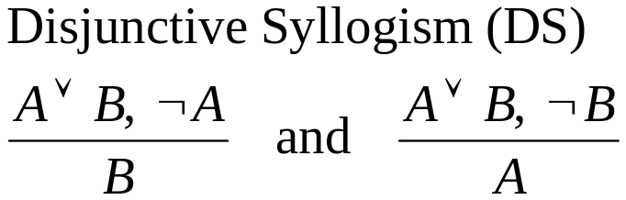
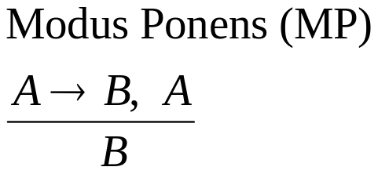
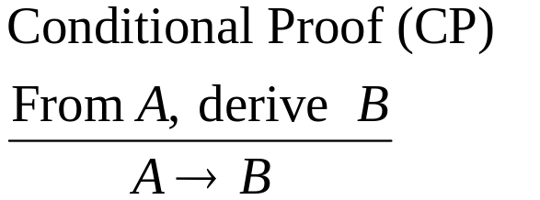
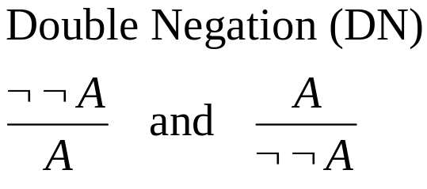
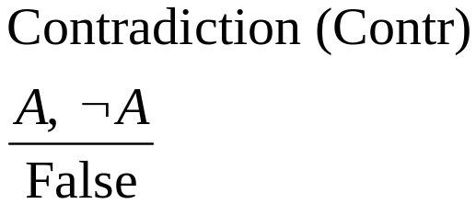
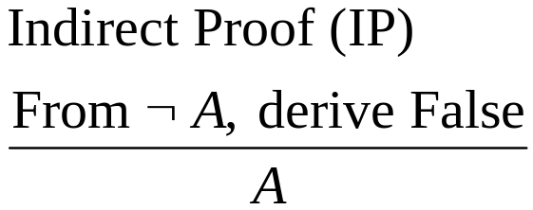
Basic Proof Rules
Notes:
Section 6.3.1
Simplification rule:
If we can conclude A ∧ B, then we may infer A
If we can conclude A ∧ B, then we may infer B
MP rule:
Infers B from A and A → B.
A ∧ (A → B) → B is a tautology
CP rule:
“From A, derive B”
“There is a derivation from the premise A that ends with B.”
IP rule:
“From ¬ A, derive False,”
“There is a derivation from the premise ¬ A that ends with a contradiction.”
Contr rule:
A ∧ ¬ A ≡ False (contradiction)

Slide 37
Proof Notation
Put each wff on a numbered line along with a reason. Use the letter P for a premise and follow the proof with QED.
Example.
Modus Ponens. If P and P → Q are true, then Q is also true.
  P Premise
  P → Q Premise
  Q 1,2 Modus Ponens (Conclusion)
  QED.

Slide 38
Proof Notation - Example
We’ll prove that the argument with premises
A ∨ C → D, ¬ B, A ∨ B and conclusion D is valid.
  A ∨ C → D P
  ¬ B P
  A ∨ B P
  A 2, 3, DS
  A ∨ C 4, Add
  D 1, 5, MP
  QED.

Slide 39
Using Conditional Proofs (CP)
If a proof consists of a derivation from a premise A to a conclusion B that does not contain any uses of CP (conditional proof) or IP (indirect proof), then we can apply CP to obtain a tautology A → B.
The reason we obtain a tautology is that the proof rules used in the derivation are valid arguments. So, the truth of A implies the truth of B, which tells us that A → B is a tautology.
When using CP in this way, instead of writing A → B, we’ll write QED along with the line numbers of the derivation followed by CP.

Slide 40
Using Conditional Proofs (CP) – Example 1
We’ll prove that (A ∨ C → D) ∧ ¬ B ∧ (A ∨ B) → D is a tautology.
  A ∨ C → D P
  ¬ B P
  A ∨ B P
  A 2, 3, DS
  A ∨ C 4, Add
  D 1, 5, MP
  QED 1–6, CP.
Notes:
(A ∨ C → D) ∧ ¬ B ∧ (A ∨ B) → D is a tautology.
A ∨ C → D P
¬ B P
A ∨ B P
A 2, 3, DS
A ∨ C 4, Add
D 1, 5, MP
QED 1–6, CP.

Slide 41
Using Conditional Proofs (CP) – Example 2
We’ll prove (A ∨ B → C ∧ D) ∧ A ∧ (C → E) → D ∧ E is a tautology.
  A ∨ B → C ∧ D P
  A P
  C → E P
  A ∨ B 2, Add
  C ∧ D 1, 4, MP
  C 5, Simp
  E 3, 6, MP
  D 5, Simp
  D ∧ E 7, 8, Conj
  QED 1–9, CP.
Notes:
(A ∨ B → C ∧ D) ∧ A ∧ (C → E) → D ∧ E is a tautology.
A ∨ B → C ∧ D P
A P
C → E P
A ∨ B 2, Add
C ∧ D 1, 4, MP
C 5, Simp
E 3, 6, MP
D 5, Simp
D ∧ E 7, 8, Conj
QED 1–9, CP.

Slide 42
Subproofs
A subproof is a proof that is part of another proof. It always starts with a new premise and always ends by applying CP or IP to the derivation from that premise. When this happens, the premise is discharged and the wffs of the derivation become inactive.
Indent the statements of the subproof and write down the result of CP or IP without indentation.

Slide 43
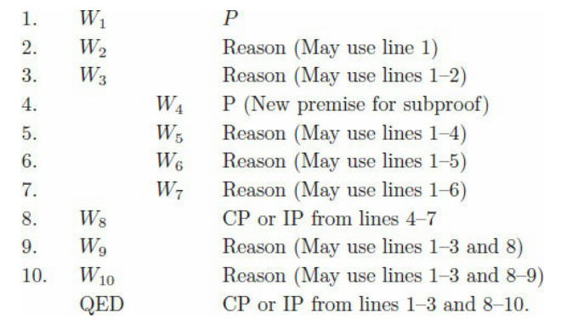
Subproof Notation
Proof Sequence: W1, … Wn

Slide 44
Subproofs – Example 1
We’ll prove that (A ∨ B) → (¬ B → A) is a tautology.
  A ∨ B P
  ¬ B P [for ¬ B → A ]
  A 1, 2, DS
  ¬ B → A 2, 3, CP
  QED 1, 4, CP.
(We’ll prove the converse shortly)
Notes:
(A ∨ B) → (¬ B → A) is a tautology.
A ∨ B P
¬ B P [for ¬ B → A ]
A 1, 2, DS
¬ B → A 2, 3, CP
QED 1, 4, CP.

Slide 45
Subproofs – Example 2
We’ll prove that (A ∨ B → C) → (A → C) ∧ (B → C) is a tautology.
  A ∨ B → C P
  A P [for A → C]
  A ∨ B 2, Add
  C 1, 3, MP
  A → C 2–4, CP
  B P [for B → C]
  A ∨ B 6, Add
  C 1, 7, MP
  B → C 6–8, CP
  (A → C) ∧ (B → C) 5, 9, Conj
  QED 1, 5, 9–10, CP.
Notes:
(A ∨ B → C) → (A → C) ∧ (B → C) is a tautology.
A ∨ B → C P
A P [for A → C]
A ∨ B 2, Add
C 1, 3, MP
A → C 2–4, CP
B P [for B → C]
A ∨ B 6, Add
C 1, 7, MP
B → C 6–8, CP
(A → C) ∧ (B → C) 5, 9, Conj
QED 1, 5, 9–10, CP.

Slide 46
Using Indirect Proofs (IP)
If a proof consists of a derivation from a premise ¬ A to the conclusion False, then we could apply CP to obtain ¬ A → False. But we also know that A ≡ ¬ A → False. So, the result of the derivation is A. This is the IP rule.
Example. We’ll prove the tautology ¬ (A ∧ ¬ A).
  ¬ ¬ (A ∧ ¬ A) P [for ¬ (A ∧ ¬ A)]
  A ∧ ¬ A 1, DN
  A 2, Simp
  ¬ A 2, Simp
  False 3, 4, Contr
  QED 1–5, IP.
Notes:
We’ll prove the tautology ¬ (A ∧ ¬ A).
¬ ¬ (A ∧ ¬ A) P [for ¬ (A ∧ ¬ A)]
A ∧ ¬ A 1, DN
A 2, Simp
¬ A 2, Simp
False 3, 4, Contr
QED 1–5, IP.

Slide 47
Using Indirect Proofs (IP) with Subproofs
IP is most often used in a subproof setting when proving a conditional of the form V → W.
Start with V as a premise for a CP proof.
Then start an IP subproof with premise ¬ W.
When a contradiction is reached, we obtain W by IP.
Then CP gives the result V → W.
As with CP subproofs, the result of IP is written with no indentation.

Slide 48
Using Indirect Proofs (IP) - Exercise
Prove the tautology (A → B) ∧ (A ∨ B) → B.
  A → B P
  A ∨ B P
  ¬ B P [for B]
  A 2, 3, DS
  B 1, 4, MP
  False 3, 5, Contr
  B 3–6, IP
QED 1–2, 7, CP.
Notes:
(A → B) ∧ (A ∨ B) → B.
A → B P
A ∨ B P
¬ B P [for B]
A 2, 3, DS
B 1, 4, MP
False 3, 5, Contr
B 3–6, IP
QED 1–2, 7, CP.

Slide 49
Using Indirect Proofs (IP) - Example
We’ll prove that the converse of (A ∨ B) → (¬ B → A).
Proof of (¬ B → A) → (A ∨ B):
  ¬ B → A P
  ¬ (A ∨ B) P [for A ∨ B]
  ¬ B P [for B]
  A 1, 3, MP
  A ∨ B 4, Add
  False 2, 5, Contr
  B 3–6, IP
  A ∨ B 7, Add
  False 2, 8, Contr
  A ∨ B 2, 7–9, IP
  QED 1, 10, CP.
Notes:
(¬ B → A) → (A ∨ B):
¬ B → A P
¬ (A ∨ B) P [for A ∨ B]
¬ B P [for B]
A 1, 3, MP
A ∨ B 4, Add
False 2, 5, Contr
B 3–6, IP
A ∨ B 7, Add
False 2, 8, Contr
A ∨ B 2, 7–9, IP
QED 1, 10, CP.

Slide 50
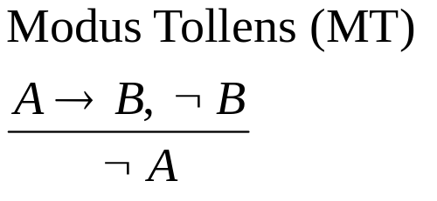
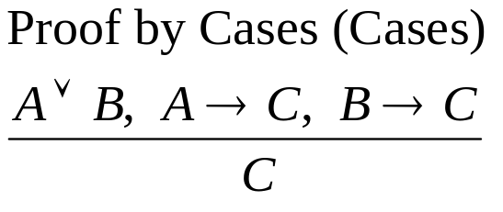
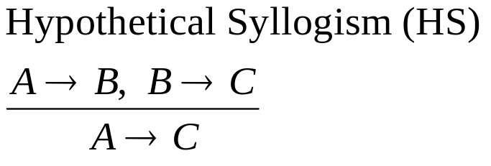
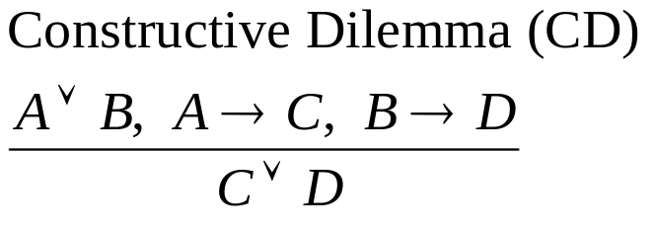
Derived Rules
Derived Rules (they follow from the original rules)
Notes:
Modus Tollens
If A, then B.
Not B.
Therefore, not A.

Slide 51
Derived Rules – First Proof
We’ll give two proofs of the tautology
(A → C) ∧ (B → C) → (A ∨ B → C).
First proof:
  A → C P
  B → C P
  A ∨ B P [for A ∨ B → C]
  C 1, 2, 3, Cases
  A ∨ B → C 3–4, CP
  QED 1–2, 5, CP.
Notes:
(A → C) ∧ (B → C) → (A ∨ B → C).
A → C P
B → C P
A ∨ B P [for A ∨ B → C]
C 1, 2, 3, Cases
A ∨ B → C 3–4, CP
QED 1–2, 5, CP.

Slide 52
Derived Rules – Second Proof
(A → C) ∧ (B → C) → (A ∨ B → C).
Second proof:
  A → C P
  B → C P
  A ∨ B P [for A ∨ B → C]
  ¬ C P [for C]
  ¬ A 1, 4, MT
  B 3, 5, DS
  ¬ B 2, 4, MT
  False 6, 7, Contr
  C 4–8, IP
  A ∨ B → C 3, 9, CP
  QED 1–2, 10, CP.
Notes:
(A → C) ∧ (B → C) → (A ∨ B → C).
A → C P
B → C P
A ∨ B P [for A ∨ B → C]
¬ C P [for C]
¬ A 1, 4, MT
B 3, 5, DS
¬ B 2, 4, MT
False 6, 7, Contr
C 4–8, IP
A ∨ B → C 3, 9, CP
QED 1–2, 10, CP.

Slide 53
Derived Rules – Exercise
Prove (A → C) ∧ ¬ (A → B) → ¬ (C → B) with IP somewhere.
  A → C P
  ¬ (A → B) P
  ¬ ¬ (C → B) P [for ¬ (C → B)]
  C → B 3, DN
  A → B 1, 4, HS
  False 2, 5, Contr
  ¬ (C → B) 3–6, IP
  QED 1–2, 7, CP.
Notes:
(A → C) ∧ ¬ (A → B) → ¬ (C → B).
A → C P
¬ (A → B) P
¬ ¬ (C → B) P [for ¬ (C → B)]
C → B 3, DN
A → B 1, 4, HS
False 2, 5, Contr
¬ (C → B) 3–6, IP
QED 1–2, 7, CP.

Slide 54
Example. Consider the following argument:
I eat spinach (S) or ice cream (I). If I study logic (L) then I will pass the exam (P).
If I eat ice cream, then I will study logic. If I eat spinach, then I will play golf (G).
I failed the exam. Therefore, I played golf.
The argument has five premises {S ∨ I, L → P, I → L, S → G, ¬ P} and conclusion G.
Prove that the argument is valid.
Alternative Proof:
6. I → P 2, 3, HS
7. ¬ I 5, 6, MT
8. S 1, 7, DS
9. G 4, 8, MP
QED.
Alternative Proof:
6. G ∨ L 1, 3, 4, CD
7. ¬ L 2, 5, MT
8. G 6, 7, DS
QED.
Alternative Proof:
6. I → P 2, 3, HS
7. G ∨ L 1, 4, 6, CD
8. G 5, 7, DS
QED.
1. S ∨ I P
2. L → P P
3. I → L P
4. S → G P
5. ¬ P P
6. ¬ L 2, 5, MT
7. ¬ I 3, 6, MT
8. S 1, 7, DS
9. G 4, 8, MP
QED.

Slide 55
Questions?

Slide 56
Section 6.4 Formal Axiom Systems
By a formal axiom system we mean a specific set of axioms (a fixed set of premises) and
proof rules. The aims of a formal axiom system are soundness and completeness::
Soundness: All proofs yield theorems that are tautologies.
Completeness: All tautologies are provable as theorems.
Frege-Lukasiewicz (F-L) Axiom System
Axiom 1: A→ (B → A).
Axiom 2: (A→ (B → C)) → ((A → B) →(A → C)).
Axiom 3: (¬ A→ ¬ B) → (B → A).
Proof Rule: MP.
Since the axioms of F-L are tautologies and MP maps tautologies to a tautology, the F-L
system is sound. The F-L system is also complete, but that takes a bit of proof (see the text).
Example (Lemma). Use the F-L system to prove A → A.
Proof: 1. A→ ((A → A) → A) Axiom 1
2. (A→ ((A → A) → A)) → ((A → (A → A)) →(A → A)) Axiom 2
3. (A → (A → A)) →(A → A) 1, 2, MP
4. A → (A → A) Axiom 1
5. A → A 3, 4, MP
QED.

Slide 57
Deduction Theorem (The CP Rule)
If A is a premise in a proof of B, then there is a proof of A → B that does not use A as a
premise.
Proof Idea: Assume the proof has the form
A = B₀, …, B_{n} = B.
If n = 0, then A = B. So we must find a proof of A → B = A → A that does not use A as a
premise. A proof was given in the previous example (lemma). Let n > 0 and assume that for
each k in the range 0 ≤ k < n there is a proof of A → B_{k} that does not use A as a premise.
Show that there is a proof of A → B_{n} that does not use A as a premise. If B_{n} is a premise or
an axiom, then we have the following proof that does not use A as a premise:
1. B_{n} Premise or Axiom
2. B_{n} → (A → B_{n}) Axiom 1
3. A → B_{n} 1, 2, MP QED.
If B_{n} is neither a premise nor an axiom, then it is inferred by MP from B_{i} and B_{j} = B_{i} → B_{n},
where i < n and j < n. So we obtain the following proof that does not use A as a premise:
1. Proof of A → B_{i} not using A as a premise Induction assumption
2. Proof of A → (B_{i} → B_{n}) not using A as a premise Induction assumption
3. (A→ (B_{i} → B_{n}))→ ((A → B_{i}) →(A → B_{n})) Axiom 2
4. (A → B_{i}) → (A → B_{n}) 2, 3, MP
5. A → B_{n} 1, 4, MP QED.
Since B_{n} = B, we have a proof of A → B that does not use A as a premise. QED.

